Slide 1
Sure-Park: Parking garage management system
2016/5/27
5 (Oh!) Team

Slide 2
Contents
Overview
Contexts
Market, Organization, Business, Technology
Stakeholders
System context diagram
Architecture drivers
Functional requirements
Quality attributes
Constraints
Initial design
Risks
Project plans

Slide 3
0. Overview
The project sponsors is Geoff’s Transportation and Parking Services (GPTS LLC).
GPTS LLC own several parking garages and lots, have concerns about inefficiencies in their parking garages and lots.
We have to enable drivers to easily find a parking facility with available parking slots and reserve them.

Slide 4
1. Contexts
Market Context
Stakeholders | Owner, Driver(s), Attendant(s), Development Team
Functional Expectations | Reduction driver frustration and enable them to easily find a parking facility with available parking slots and reserve them.
System Access | Users want to access the system via laptops, pads, phones.
Organizational Context
Roles and Responsibilities | Project Manager Architect Requirement Manager Test Manager Development Team : Server developer (Business logic) : UI Application developer : Embedded system developer (Arduino)
Team culture | Open-minded Be the first Make customer happy

Slide 5
1. Contexts
Business Context
Date of delivery | 6/24, 2016
Time resources | 1,050 hours (35 Working days * 6 Hours * 5 People)
Strategy | More efficiently utilize the space in their parking facilities thereby increasing profits
Cost obligations | More efficiently utilize personnel and reduce the number of people required to operate any given garage reducing operating costs
Profit model | Selling management & reservation system for parking equipment
Technical Context
Languages | Java (Android), C/C++ (Arduino)
Tools | Android Studio, Arduino IDE, Eclipse, MySQL
Operating System | Windows, Arduino Sketch, Android
Hardware | Laptop, Arduino MEGA 2560 (Wi-Fi enabled), Android devices

Slide 6

1. Contexts
Stakeholders and their expectations
Concern about inefficiencies in their parking garages and lots
More efficiently utilize the space in their parking facilities thereby increasing profits
Reduce traffic congestion and the chance for accidents inside the parking facilities reducing liabilities
More efficiently utilize personnel and reduce the number of people required to operate any given garage reducing operating costs
Owner
Reduce frustration and easily find parking in desired locations
System is easy to use and reserve a parking slot
Driver

Slide 7

1. Contexts
Stakeholders and their expectations
Want to develop in due-date
Want to stabilize the requirements in early stage
Want to design a system with modifiability, performance, and reliability
Want to have sufficient time to test
Want to take a rest and enjoy beautiful Pittsburgh
Development
Team
Hehe, nakalru?
Attendant

Slide 8
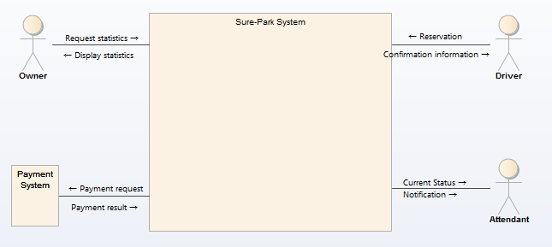

1. Contexts
System context diagram
Actors
External System

Slide 9
2. Architecture drivers
Detailed usecases
3. Park a car
1. Manage
2. Reserve a slot

Slide 10
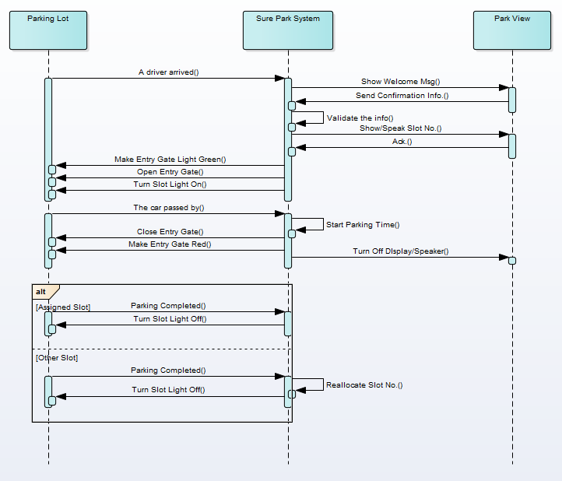
2. Architecture drivers
System sequence diagram : 3.1 Parking
Based on usecase scenario, we made system sequence diagram for each usecase.
Based on this system sequence diagrams, we will design interfaces between sub-systems.

Slide 11
2. Architecture drivers
Functional requirements with “High” priority
ID | UC # | Functional Requirements
FR-101 | UC 1.1 | The system should provide daily average occupancy of selected parking lot.
FR-108 | UC 1.2 | The system should provide the parking state per parking space.
FR-121 | UC 1.4 | The system shall be able to set grace period for each parking lot.
FR-126 | UC 1.5 | The system should be able to manage account-specific authorities.
FR-134 | UC 1.6 | The system shall be able to add an additional parking lot.
FR-201 | UC 2.1 | The system shall be able to provide at least one method for parking reservation.
FR-308 | UC 3.1 | System shall be able to detect the parking slot that driver parked.
FR-313 | UC 3.2 | System shall request to pay parking fee with registered card, when driver unparking.

Slide 12
2. Architecture drivers
Quality attributes with “High” priority
ID | UC # | Ability | Description
QA-04 | UC 1.2 | Performance | When the system should deliver a notification to the attendant, it must be delivered within 3 seconds.
QA-07 | UC 1.5 | Security | The system should be able to restrict access to each function of the account authority.
QA-10 | UC 2.1 | Performance | The system shall provide confirmation information within 3 seconds on parking reservation complete.
QA-11 | UC 3.1 | Reliability | System shall be able to detect arrival of driver 99% at entry/exit gate of parking lot.
QA-14 | - | Availability | The parking system shall be available for 24 * 7 * 365 without stop.

Slide 13
2. Architecture drivers
Constraints - Business
ID | Type | Description
CST-01 | Business | The system should more efficiently utilize personnel and reduce the number of people required to operate any given garage reducing operating costs.
CST-02 | Business | The system should reduce traffic congestion and the chance for accidents inside the parking facilities reducing liabilities.
CST-03 | Business | The system should be scalable to N facilities.
CST-04 | Business | The system should reduce driver frustration and enable them to easily find a parking facility with available parking slots and reserve them.
CST-05 | Business | The system should more efficiently utilize the space in their parking facilities thereby increasing profits.
CST-06 | Business | The parking lot system only accept a driver with reservation.
CST-07 | Business | The parking lot system only accept a credit card for payment.

Slide 14
2. Architecture drivers
Constraints - Technical
ID | Type | Description
CST-08 | Technical | The system need network for reservation, payment and management.
CST-09 | Technical | The system need some data storing mechanism for store data (reservation, payment, revenue and so on)
CST-10 | Technical | The system cannot change the type of controller, sensors, or actuators (e g. gate lift servo), although use multiple controllers to accommodate a larger facility.
CST-11 | Technical | The system must check with the owner before using open software.
CST-12 | Technical | The system should not store driver's payment information as it is.

Slide 15
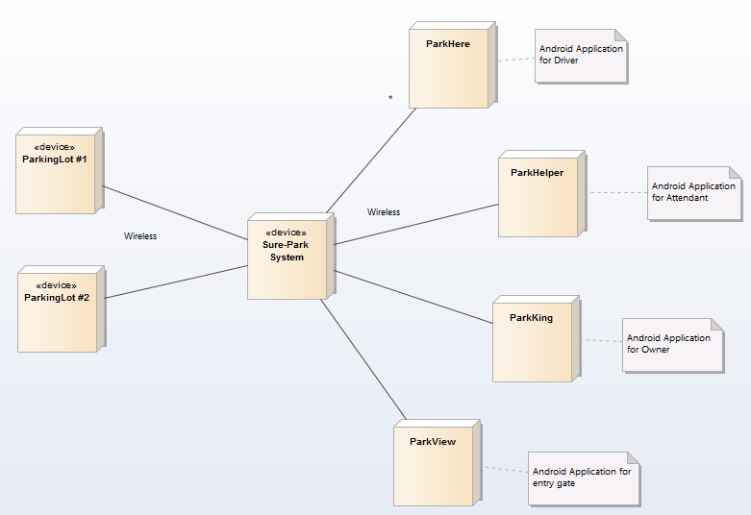
2. Architecture drivers
Initial design – Allocation view

Slide 16
3. Risks
We identified several risks
ID | Impact | Probability | Risk
RID-01 | 4 | 2 | No experience on developing with Arduino
RID-02 | 3 | 2 | No experience on developing with server-client system
RID-03 | 5 | 5 | Too short time for project
RID-04 | 4 | 4 | Requirement change occurred by customer
RID-05 | 3 | 3 | Difficulty on scale up of parking lots
* Impact defines between 1 (minimal) to 5 (catastrophe)
* Probability defines between 1 (unlikely) to 5 (likely)

Slide 17
3. Risks
We are ready to mitigate identified risks.
ID | Risk | Mitigation plan | Expectation
RID-03 | Too short time for project | - We will work at weekend to make more time to work. - We will make centralized design to manage system complexity in one place. - We will choose an experienced way to develop UI applications | Probability will goes down 5 → 3 or 2 at 6/1
RID-04 | Requirement change occurred by customer | - We will ask customer every day whether requirements are changed or not. - We will make a strong design for requirement change. | Probability will goes down 4 → 2 at 6/5

Slide 18
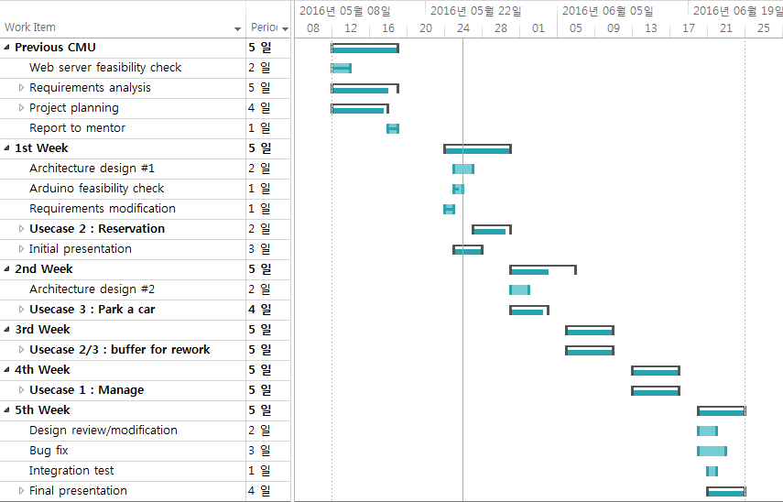
4. Project plans
We made a strong iterative plans to achieve goal
1 week for 1 usecase group
Test is also completed in each week
1 week for buffer to mitigate risks

Slide 19
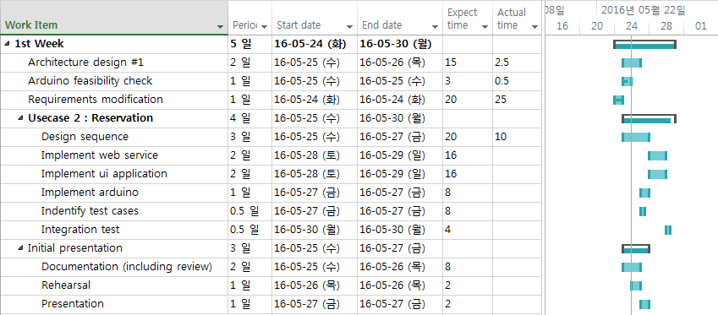
4. Project plans
Detailed plans for first week
Plan is changed due to test and reading assignment for 1st week

Slide 20
4. Project plans
Roles and Responsibility
Role | Primary owner | Secondary owner | Remarks
Project Manager | Jaedo Jin | Sanghee Lee | -
Architect | Sanghee Lee | All | -
Requirement Manager | Kimoon Lee | Sanghee Lee | -
Test Manager | Daedon Jeon | Sanghee Lee | -
Web-server developer | Yongchul Park | Jaedo Jin | -
UI App developer | Kimoon Lee | Jaedo Jin | Andriod App Experts
Embedded system developer | Daedon Jeon | - | Embedded system expert
Configuration manager | Yongchul Park | Sanghee Lee | -
Database manager | Sanghee Lee | Yongchul Park | -

Slide 21
4. Project plans
Time logs

Slide 22
Appendix. Usecase diagram
Level 1

Slide 23
Appendix. Usecase scenario example
3.1 Parking
Use Case Title : Parking | Use Case ID : UC 3.1
General use case description: This use case describe how to park a car in parking lot
Entities involved: Driver, Attendant
Preconditions: The driver arrives parking lot within grace period of reservation.
Primary use case flow of events:
1. System recognize arrival of driver.
2. System request to enter the confirmation information.
3. Driver enters confirmation information.
4. System verify confirmation information.
5. System display park space identifier.
6. System open the entry gate.
7. System turn a green right on to show where to park.
8. Driver park at assigned parking lot.
9. System recognize parking successfully ….
Primary use case post-conditions: Driver park a car in assigned parking lot.
Alternate use case #4-A, #8-A
4-A.1 If driver's confirmation information is not valid, system call nearest attendant.
8-A.1 If driver do not park a car at assigned parking lot, system recognize this problem.
8-A.2 System reallocate problem-making car's assigned parking lot to its parked place.

Slide 24
Appendix. QA scenario example
3.1 Parking
ID | QA-11 (Performance)
Source of stimulus | Driver
Stimulus | Driver arrives at the entry gate (entry IR detector).
Artifacts | Arduino system
Environment | Driver is detected by entry IR detector.
Response | Arrival of driver
Response measure | The system requires 99% rate of success as a detection of arrival.

